Slide 1

Investment Portfolio Analysis
Project 1 – Jacob Mannix

Slide 2

Agenda
Overview of Portfolio
Initial Investment Strategy
Overview of the ETL Pipeline
Analysis of Investments
Conclusions & Takeaways
Looking at the Code

Slide 3

Overview of Portfolio
Stocks
AAPL (Apple Inc.)
JNJ (Johnson & Johnson)
JPM (JPMorgan Chase & Co.)
MSFT (Microsoft Corporation)
ETFs
SPY (SPDR S&P 500 ETF Trust)
VTI (Vanguard Total Stock Market ETF)
Index
NDX (Nasdaq 100)
Forex Pairs
EURUSD (Euro/US Dollar)
USDJPY (US Dollar/Japanese Yen)

Slide 4
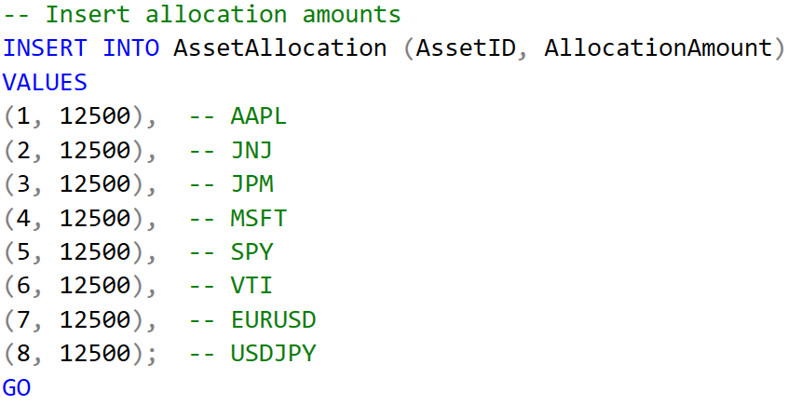
Initial Investment Strategy
Total Initial Investment = $100,000
Distribution = $12,500 per Stock

Slide 5
Pipeline strategy - ELT
Extract
Extract Stock Data from Polygon
Load
Load data into MSSQL Database
Transform
Transform data with views

Slide 6
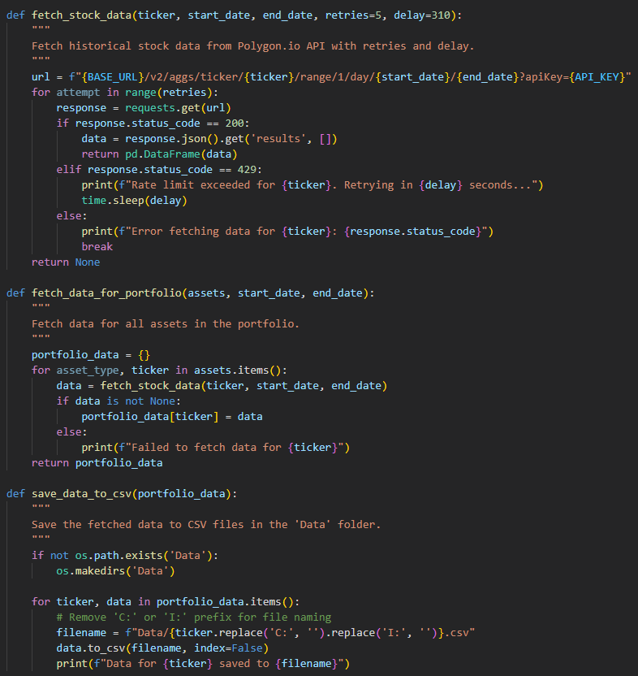
Steps to the pipeline: Extraction
Data Sources:
API: polygon.io
Python Scripting:
Pandas, Requests, OS, Datetime, Time
Stored Fetched RAW Data to CSV
Notes:
Implement a function to fetch historical data from Polygon.io API with retries and delay to handle rate limits
Store the fetched data in a dictionary and save it to CSV files for further processing

Slide 7
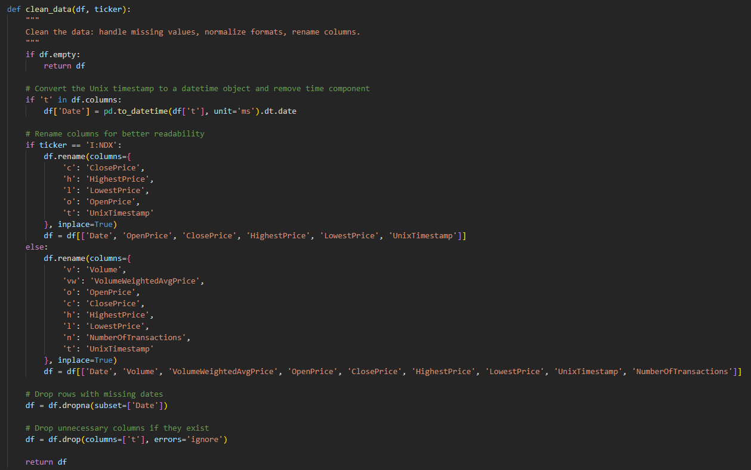
Steps to the pipeline: Cleaning
Date Formatting
Adjust Column Names
Handle Missing Values:
Forward Fill

Slide 8
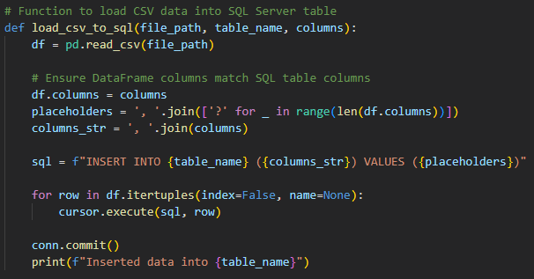
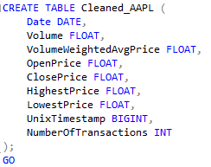
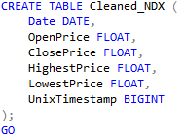
Steps to the pipeline: Cleaning
Steps to the pipeline: Load
Used pyodbc to connect to Database
Defined tables for the CSVs
Loaded the Data Using INSERT

Slide 9
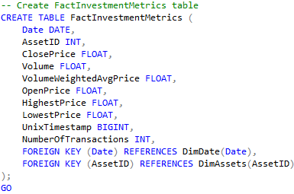
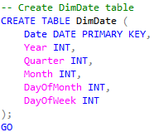
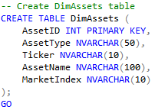
Steps to the pipeline: Data Transformation
Star Schema:
Fact Table: FactInvestmentMetrics
Dimension Tables:
DimAssets
DimDate
Views Created:
Used as the transformations
Notes:
FactInvestmentMetrics: Central table containing transactional data related to investments (e.g., prices, volumes, returns).
DimAssets: Metadata about each asset (e.g., stocks, ETFs, Forex).
DimDate: Detailed date information (e.g., day, month, year).

Slide 10
Ensuring Data Quality, Consistency, and Accuracy
Data Quality Checks
Missing Values
Data Consistency
Normalization
Data Accuracy
Data Validation

Slide 11
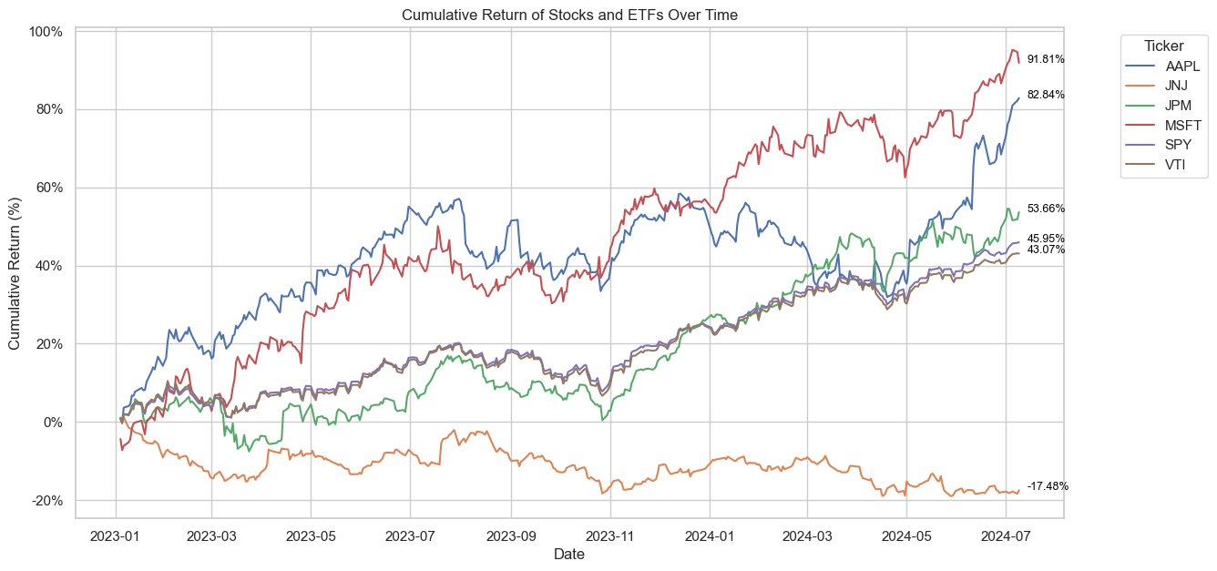
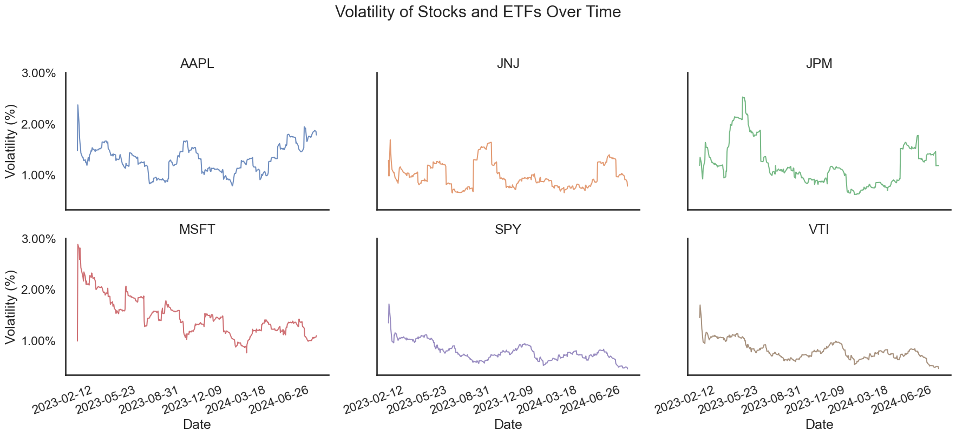
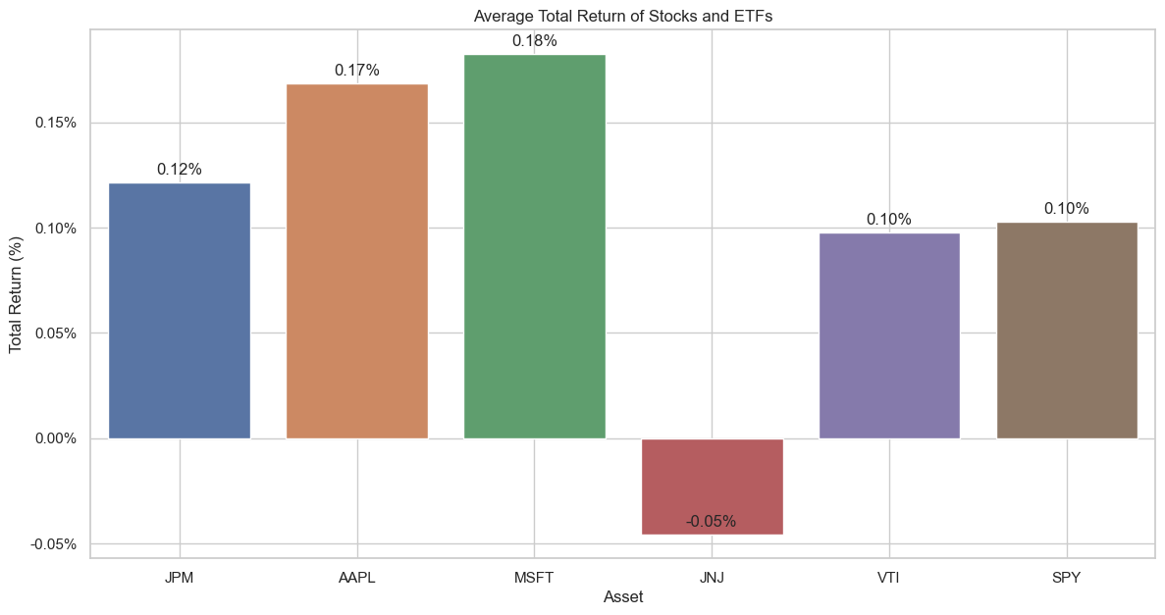
Stocks and ETFs Metrics

Slide 12
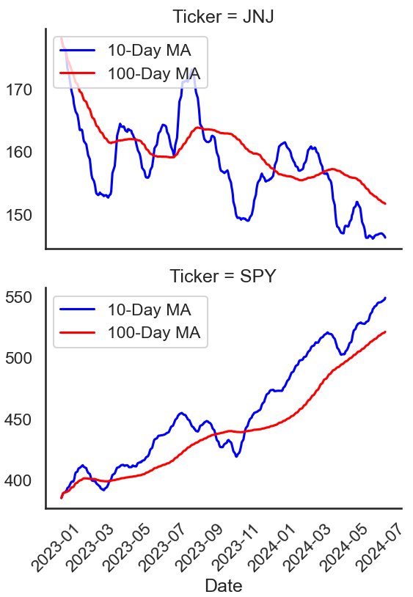
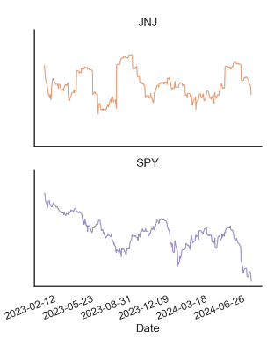
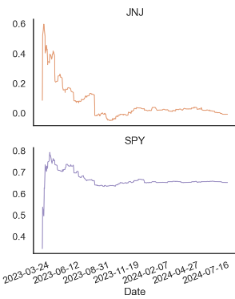
10-day and 100-day moving averages
Sharpe ratio of stocks and ETFs
Beta of stocks and ETFs

Slide 13
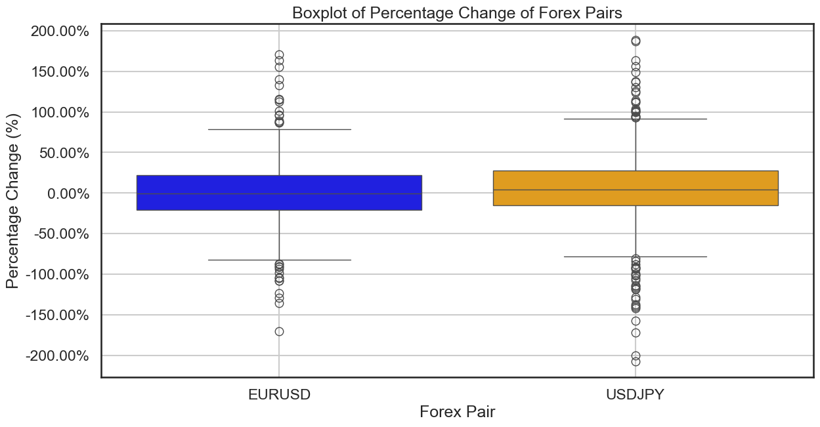
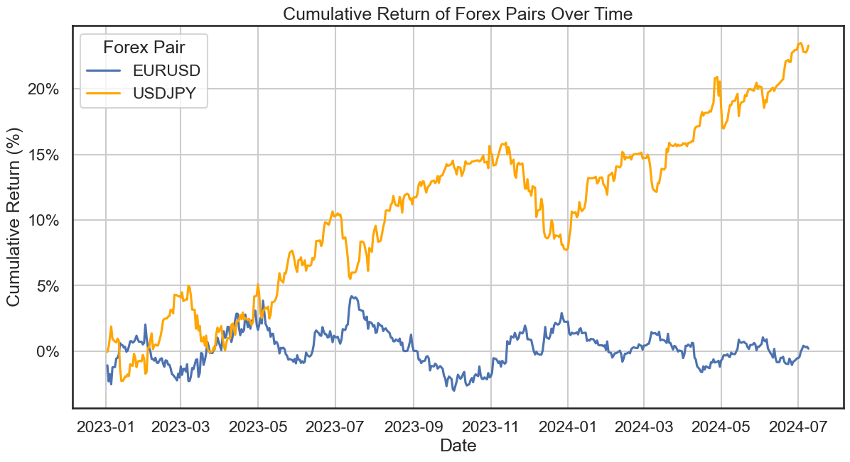
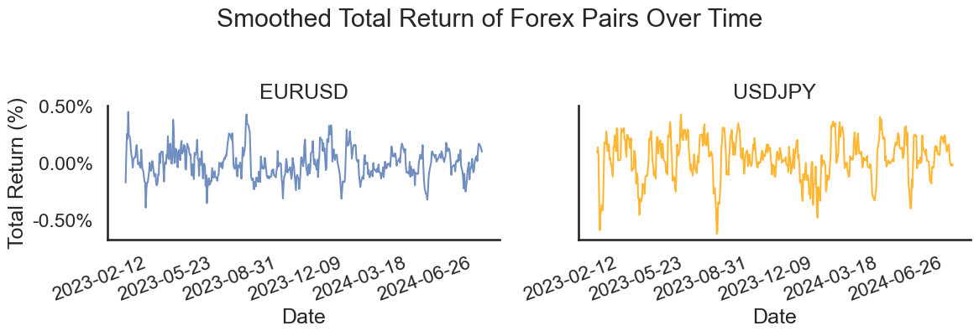
Forex Metrics

Slide 14
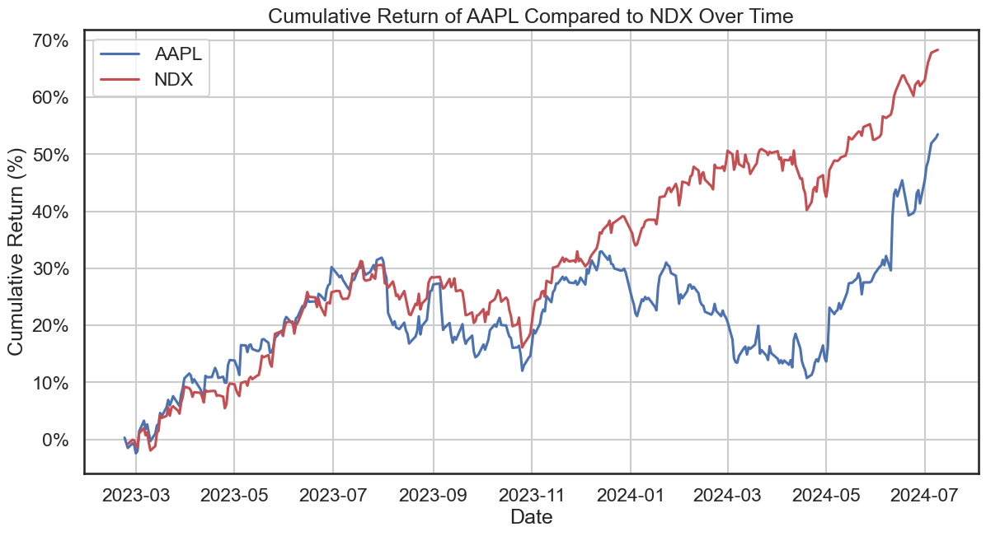
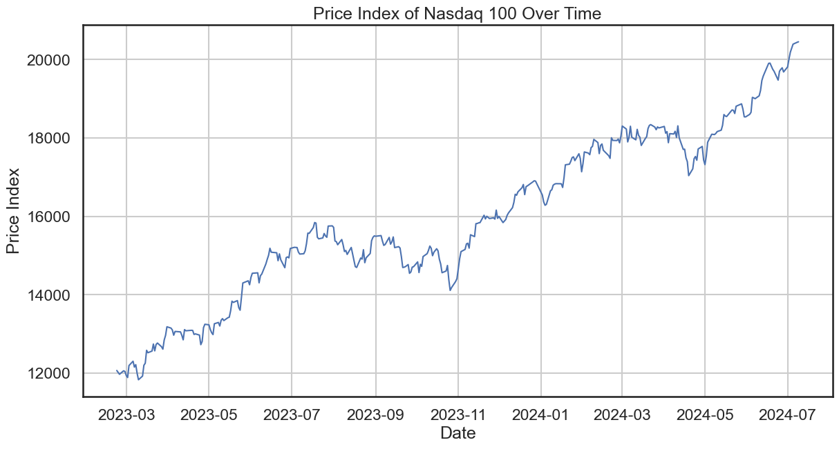
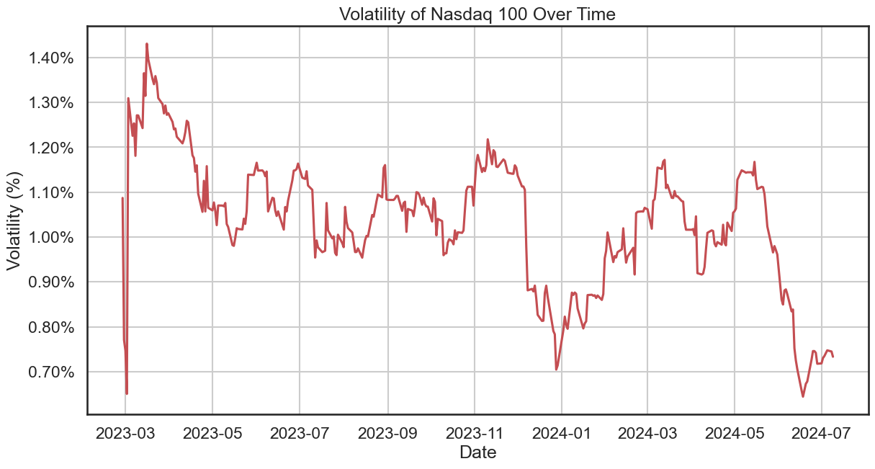
Indices Metrics

Slide 15
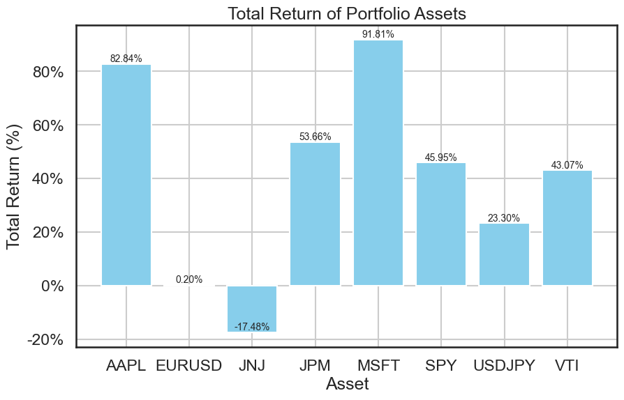
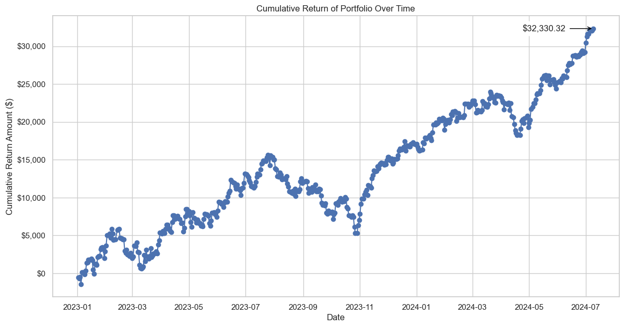
My Portfolio Metrics
Profit of $32,330.32

Slide 16
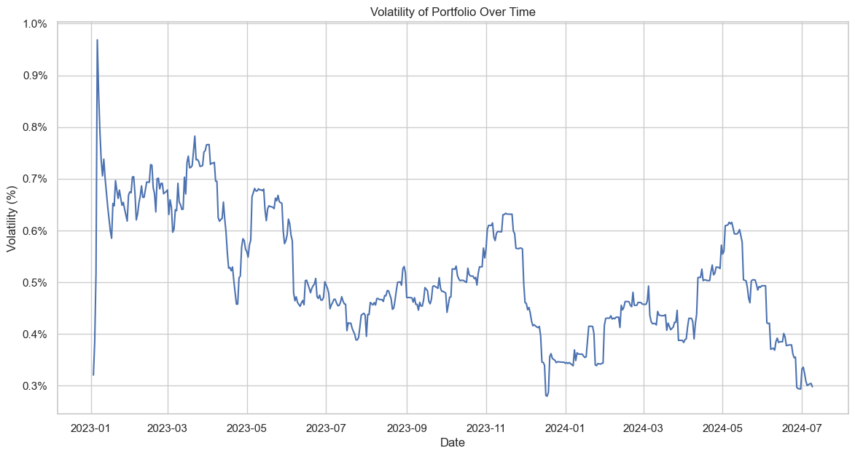
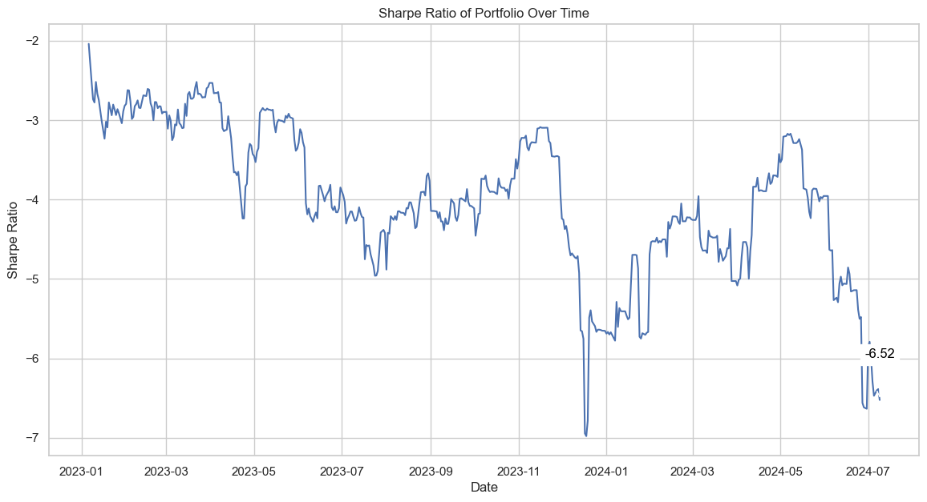
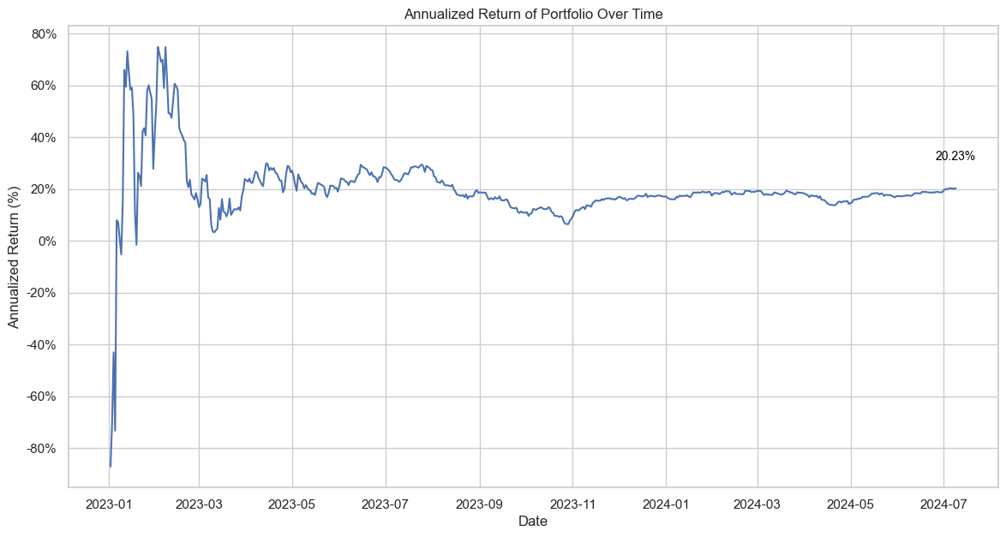

Slide 17
Takeaways
For future portfolios
Consider higher allocation to AAPL and MSFT.
Monitor JNJ closely or reduce its allocation.
Explore more Forex pairs for diversification, considering their volatility and returns.
Notes:
AAPL and MSFT are strong performers with consistent growth and lower risk.
JNJ requires closer monitoring due to higher volatility and lower returns.
SPY and VTI are stable, reflecting broader market trends.

